Slide 1
Statistical approach for dealing with inbound transportation problem

Slide 2
INTRODUCTION

Slide 3
Introduction
Efficient inbound transportation is a critical component of supply chain management, as it directly impacts the timely and cost-effective delivery of raw materials and components to manufacturing facilities. In recent years, the integration of statistical methods with lean and Six Sigma principles has emerged as a powerful approach for optimizing inbound transportation systems.
This project aims to explore the application of statistical techniques in conjunction with lean and Six Sigma methodologies to enhance the efficiency, reliability, and cost-effectiveness of inbound transportation operations.

Slide 4
LITERATURE SURVEY

Slide 5
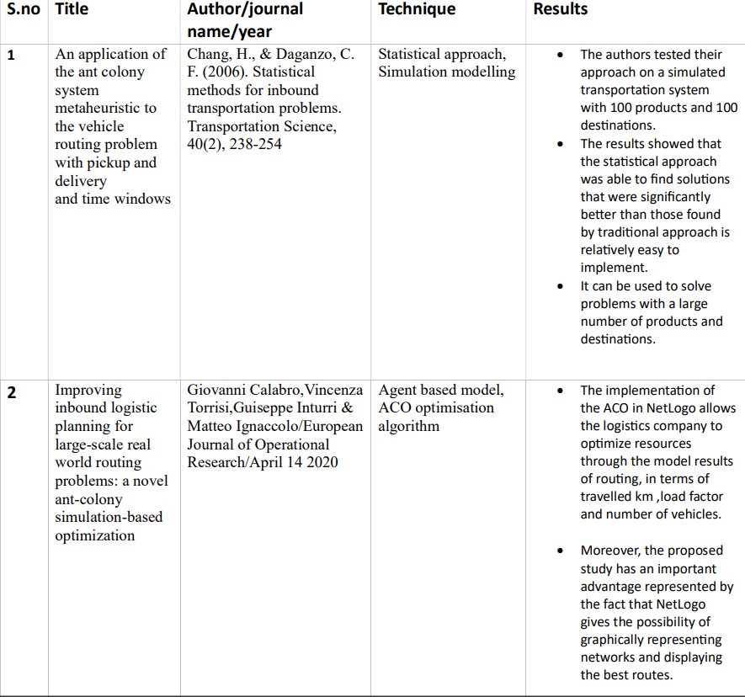

Slide 6
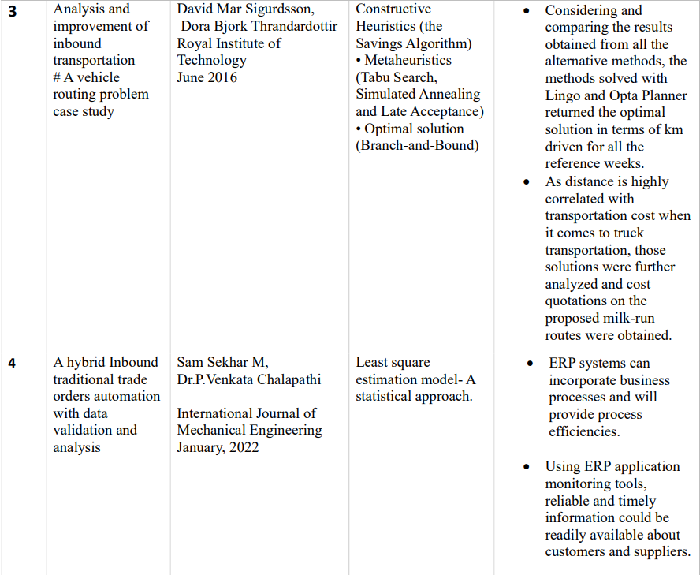

Slide 7
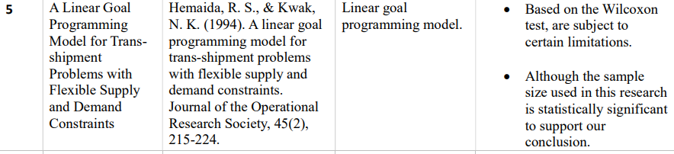
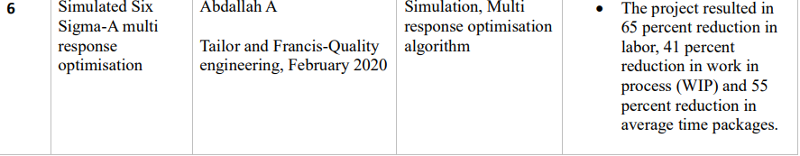

Slide 8
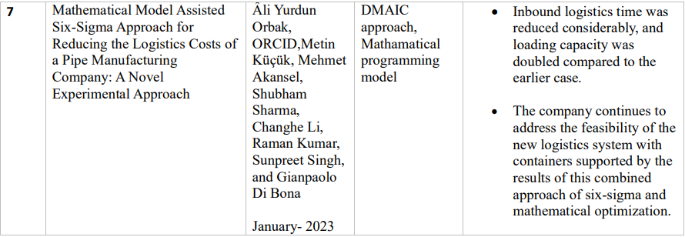

Slide 9
METHODOLOGY

Slide 10
Methodology
1. Data Collection:
For our project we will be using an existing dataset in GitHub that consists of shipments of last 18 months consolidating a total of 269 records.
2. Formulate the Hypotheses:
Start by formulating the null and alternative hypotheses. In this case, the null hypothesis (H0) is the drivers are not avoiding to opt for northern hub. The alternative hypothesis (Ha) is the drivers are avoiding to opt for northern hub.
3. Calculate Expected Frequencies:
Calculate the expected frequencies for each cell in the contingency table. This can be done using statistical software or by manual calculations. The expected frequencies represent the values that would be expected if there were no relationship between the shortage of drivers and the variables being examined.

Slide 11
Methodology
4. Perform the Chi-Squared Test:
Calculate the chi-squared statistic by comparing the observed frequencies in the contingency table with the expected frequencies. This can be done using statistical software or by manual calculations. The chi-squared statistic measures the deviation between the observed and expected frequencies, indicating whether there is a significant association between the shortage of drivers and the variables under investigation.

Slide 12
PROJECT TIMELINE

Slide 13
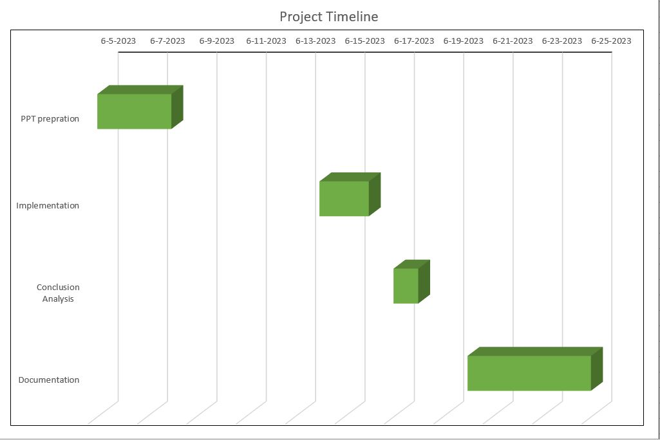
Project Timeline

Slide 14
PROBLEM DEFINITION

Slide 15
Problem Definition
A small factory has two transportation routes:
Route-1: Coming from northern regional hub.
Route-2: Coming from southern regional hub.
When ever an inventory is full in southern regional hub it is transferred to northern regional hub.
When an order is allocated to northern regional hub, the lead time to get the request accepted in northern region hub is higher than southern region hub.
Are these drivers avoiding as much as possible to the north route ?

Slide 16
RESULT AND ANALYSIS

Slide 17
Result and Analysis
The P-value obtained after performing chi-square test is 0.41
Since the P-value is greater than 0.05 there is no significant proof that driver’s allocation is linked to the hub.
Therefore we need to find out other factors that are contributing to lead time.

Slide 18
Thank You
Shashank Ravoor: 19MIA1105
Amulya: 19MIA1054
Rajesh: 19MIA1102
Akshitha: 19MIA1096

